Slide 1





Developing GraphQL Using Azure Functions
http://xquisite.ai
Sample project using VsCode

Slide 2
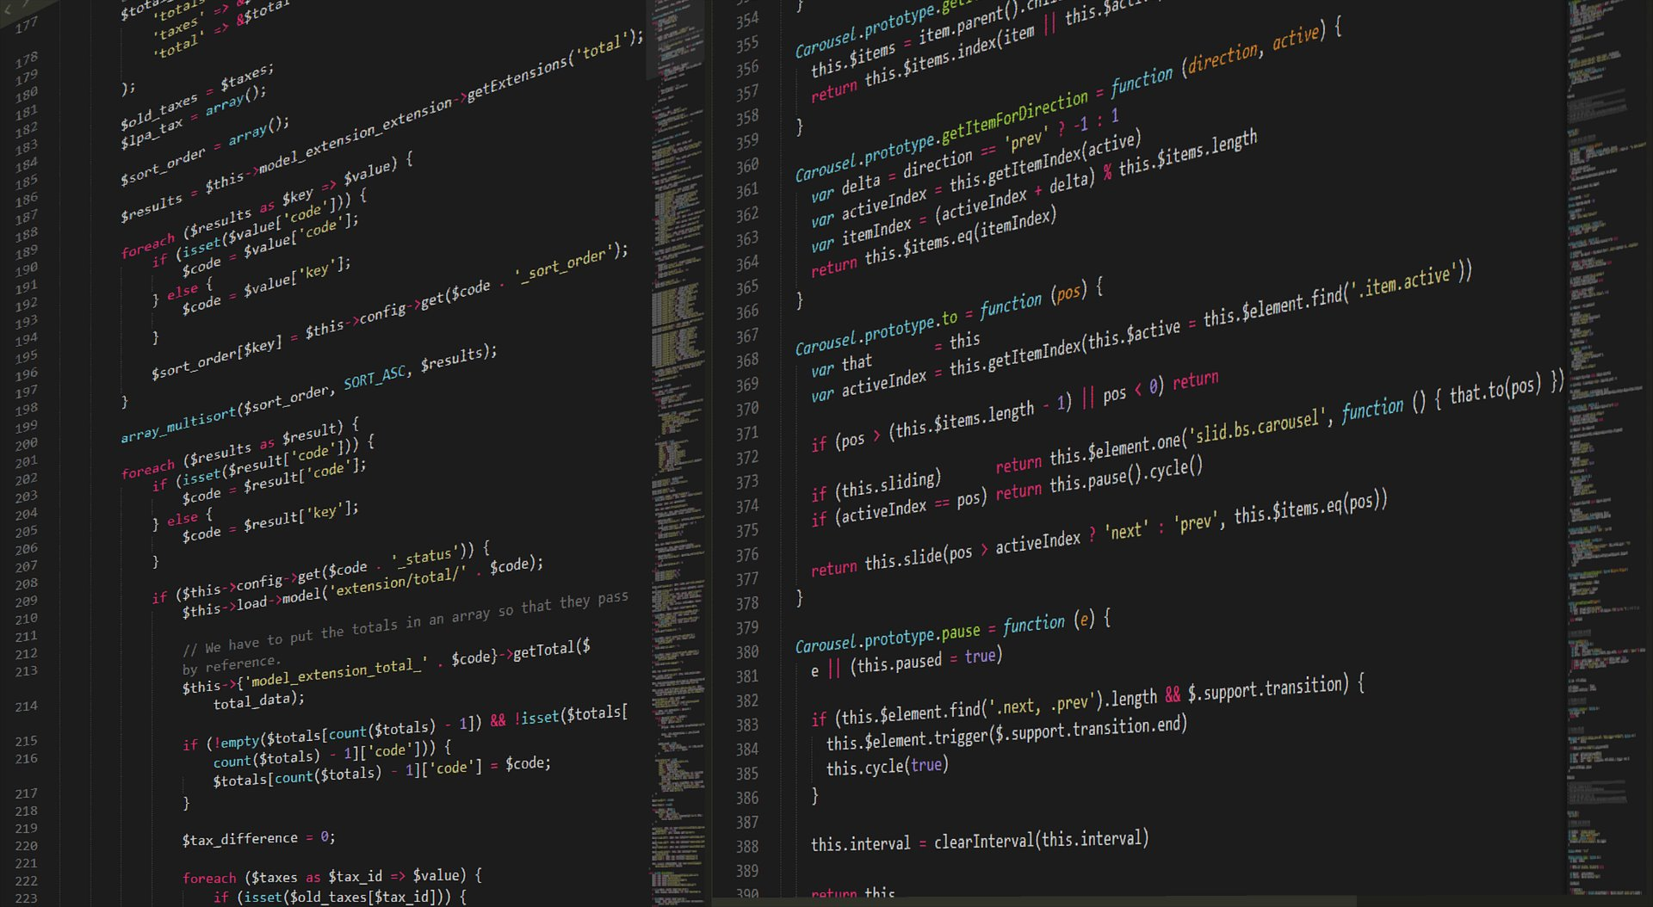


About Me
take you closer to AI
Quick Profile
Certified Azure AI Engineer
Using Python since 2015
Mainly developing on PySpark and backend API engine
Past Projects
Data integration for merchant venues – FMCG Manufacture
Consumer profiling – Ad Exchange
Big data analytics – Banking & Airlines
yanuar@xquisite.ai

Slide 3

Company History
take you closer to AI
2021
Focusing on Data and AI
Rebranding into Xquisite AI and fully focused on Data, Machine Learning, and Artificial Intelligence
2019
Production Grade Enterprise ML
First project in delivering Machine Learning implementation in nation-wide production environment
2017
Big Data Analytics
Partnered with Big Data principals to deliver end-to-end big data and analytics use case implementations
2016
Inception
Our company was founded with Xquisite Informatics as the brand identity focusing on big data and analytics

Slide 4







Microsoft Partner Network
take you closer to AI
XQ is an Official
We are aiming for Data and AI competency.
Our current Microsoft Data & AI Certification:
x4
x11

Slide 5


Our Services
+ 30
+ 60
Customers trusted us for their analytics projects
Data Analytics projects successfully completed
As of December 2020
End-to-end AI/Machine Learning, or Advanced Analytics Implementation
Data Management (Data Warehousing, ETL/ELT, mart, etc) and Visualization (Report and Dashboards)
External Data Acquisition (Social Media Data Crawling, News Sites Scrapping, and more)

Slide 6
What Will We Learned
GraphQL
Creating Azure Functions on Azure Portal
Developing GraphQL using Azure Functions on Visual Studio Code

Slide 7
GraphQL
What is GraphQL
GraphQL is a query language for APIs and a runtime for fulfilling those queries with your existing data. GraphQL provides a complete and understandable description of the data in your API, gives clients the power to ask for exactly what they need and nothing more, makes it easier to evolve APIs over time, and enables powerful developer tools.
(https://graphql.org/)

Slide 8
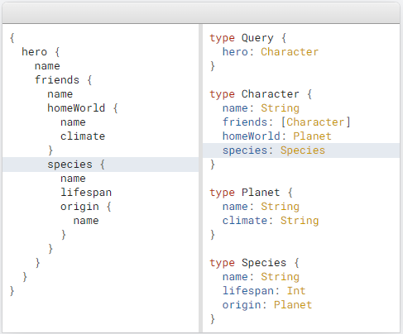
GraphQL
What is GraphQL

Slide 9
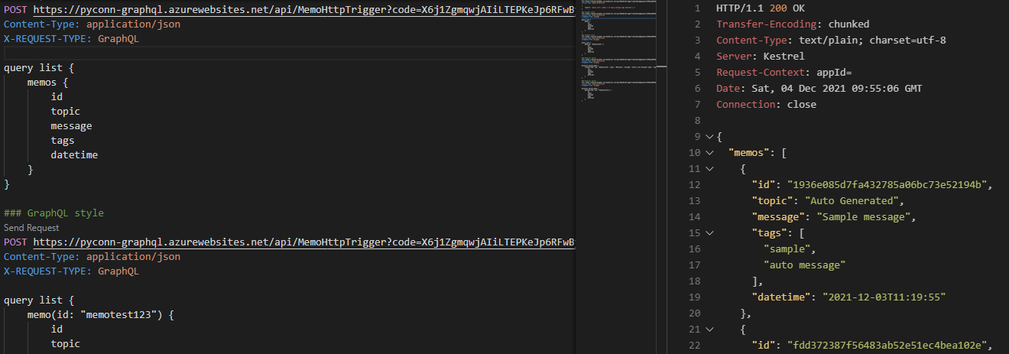
GraphQL
What is GraphQL

Slide 10
GraphQL
Why should I use GraphQL
Aggregate data from multiple UI components
Create a representation of your data that feels familiar and natural (a graph)
Ensure that all your data is statically typed, and these types inform what queries the schema supports
Reduce the need for breaking changes but utilize a built-in mechanism for deprecations when you need to.

Slide 11
GraphQL
Does GraphQL replace REST?
No, not necessarily. They both handle APIs and can serve similar purposes from a business perspective. GraphQL is often considered an alternative to REST, but it’s not a definitive replacement.
GraphQL and REST can actually co-exist in your stack. For example, you can abstract REST APIs behind a GraphQL server. This can be done by masking your REST endpoint into a GraphQL endpoint using root resolvers.
GraphQL FAQ (https://graphql.org/faq/#does-graphql-replace-rest)

Slide 12
GraphQL
Python support
There are 21 repositories on graphql-python organization on GitHub (https://github.com/graphql-python/)
Graphene – GraphQL framework for Python
graphene-Django, graphene-pydantic, graphene-sqlalchemy, etc – Graphene extension libraries for various framework

Slide 13

Azure Functions
Overview

Slide 14
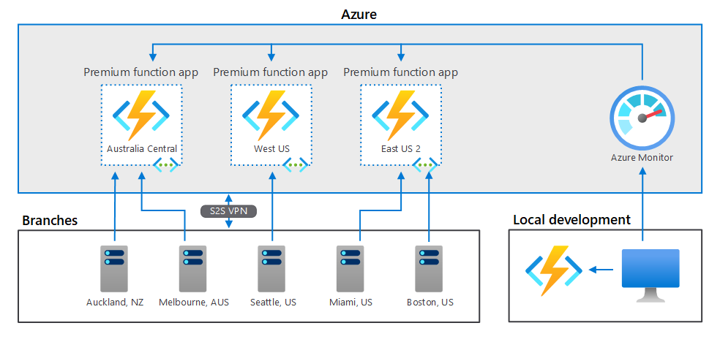
Azure Functions
Overview

Slide 15
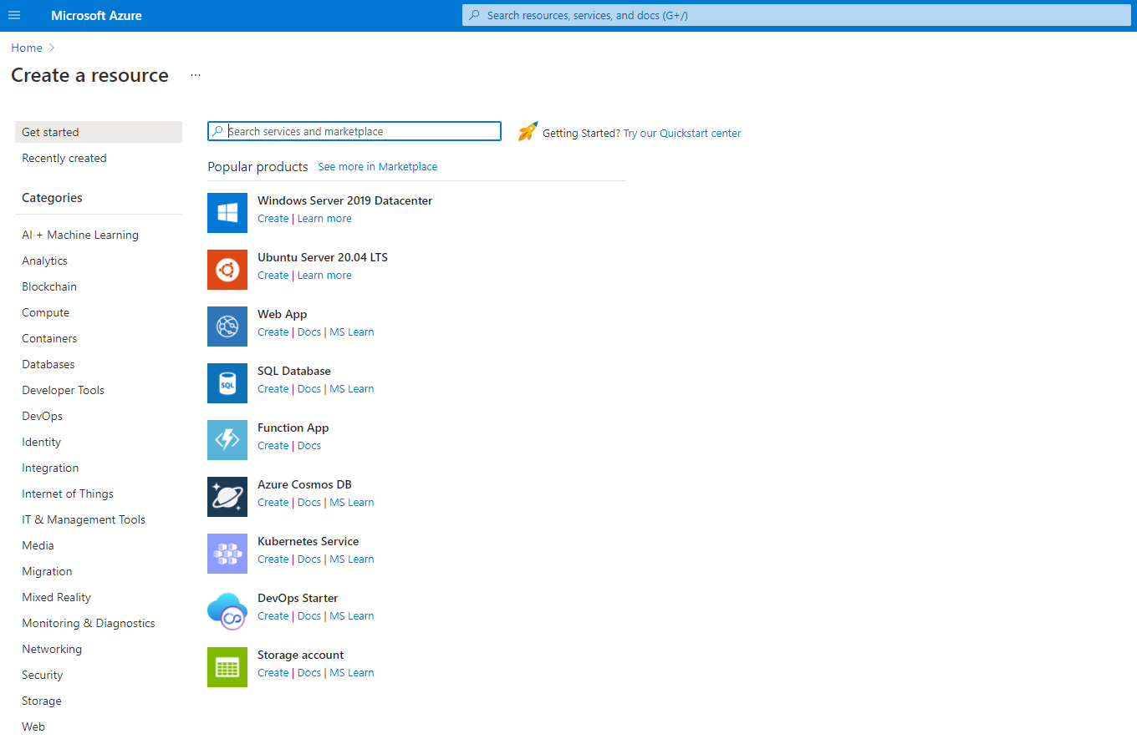
Azure Functions
Creating Azure Functions

Slide 16
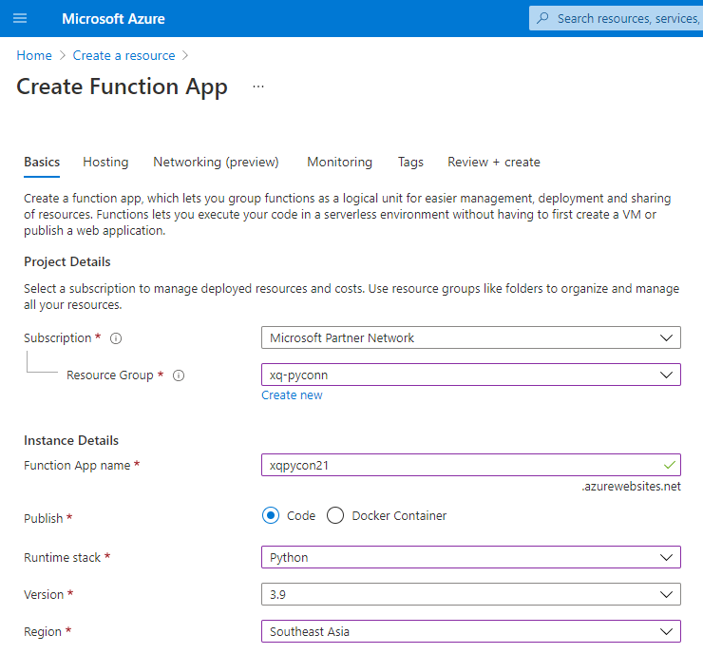
Azure Functions
Creating Azure Functions

Slide 17
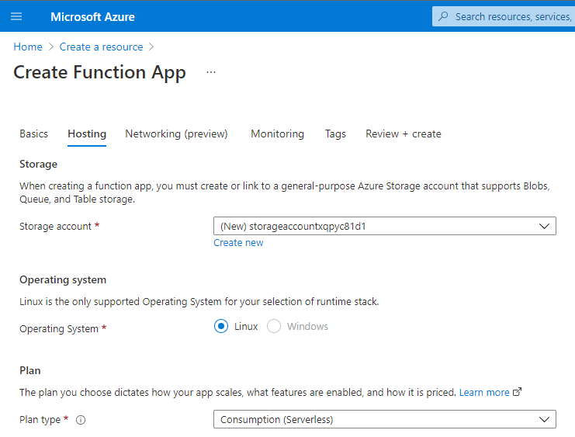
Azure Functions
Creating Azure Functions

Slide 18
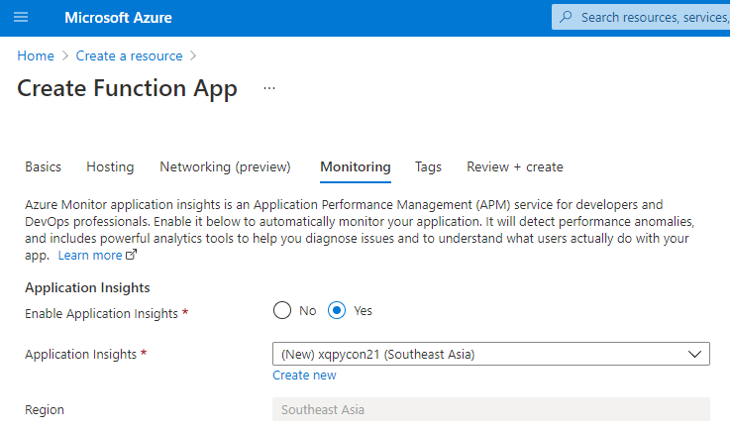
Azure Functions
Creating Azure Functions

Slide 19
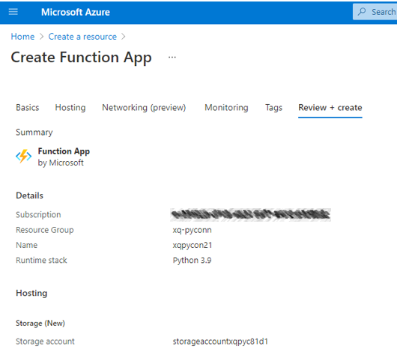
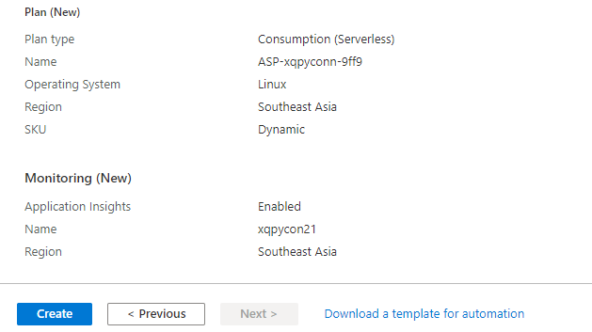
Azure Functions
Creating Azure Functions

Slide 20
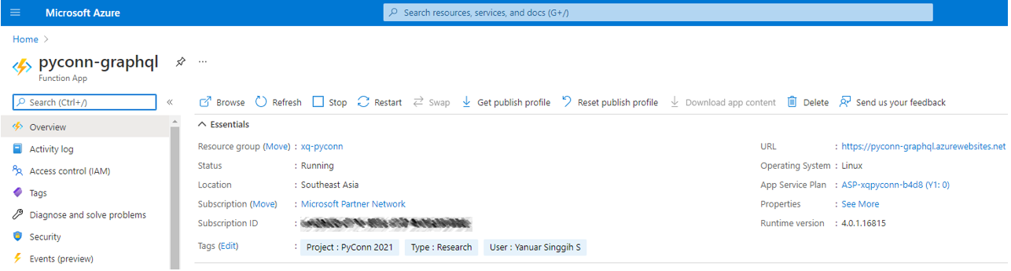
Azure Functions
Creating Azure Functions

Slide 21
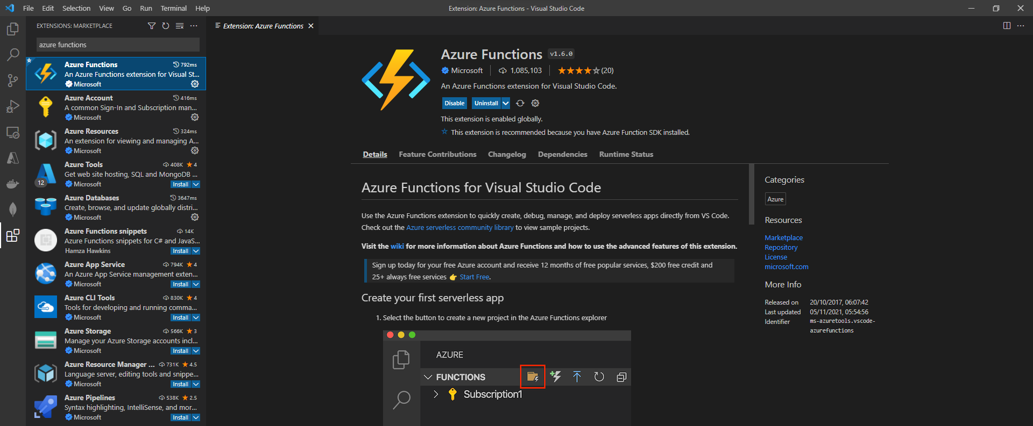
Azure Functions
Creating Azure Functions

Slide 22
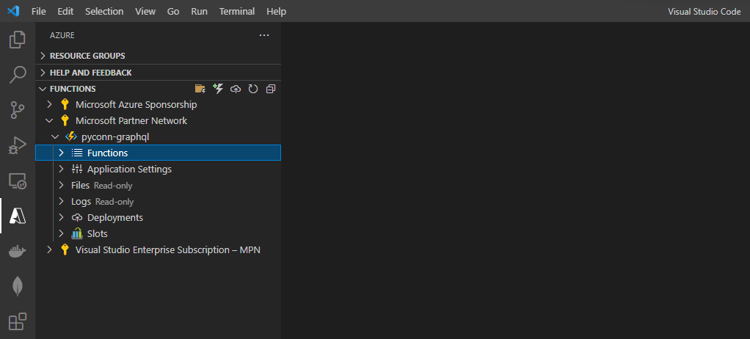
Azure Functions
Creating Azure Functions

Slide 23
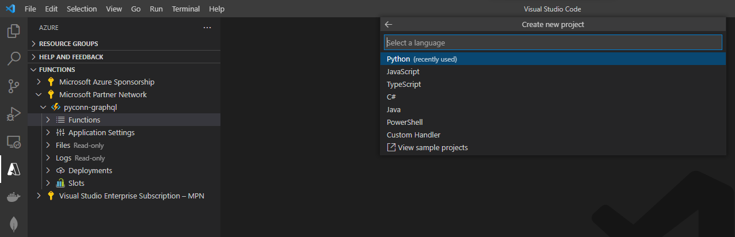
Azure Functions
Creating Azure Functions

Slide 24
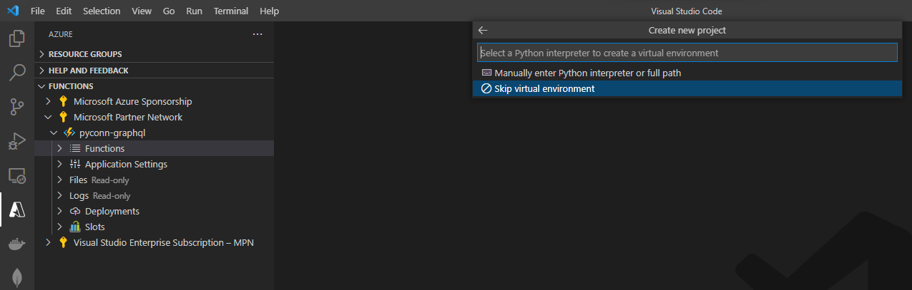
Azure Functions
Creating Azure Functions

Slide 25
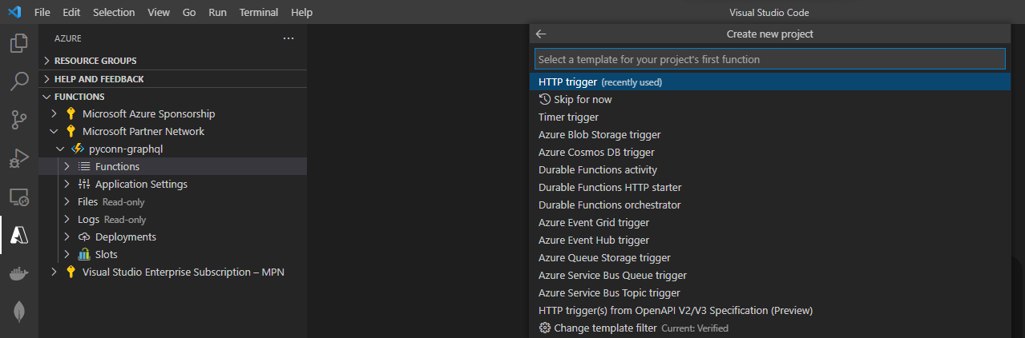
Azure Functions
Creating Azure Functions

Slide 26
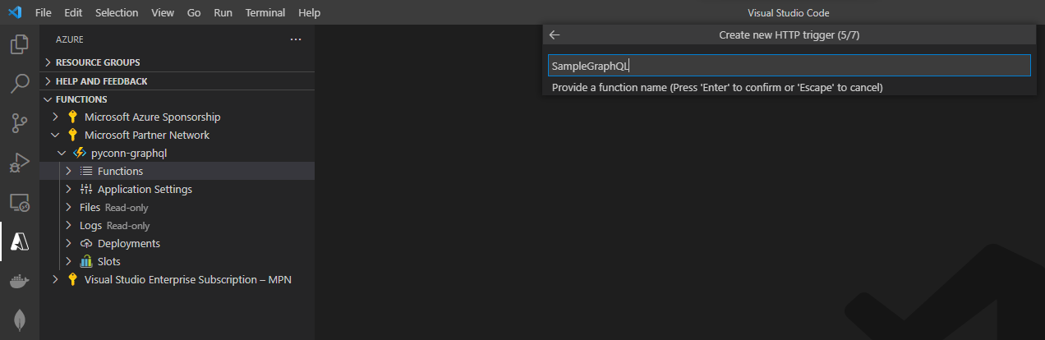
Azure Functions
Creating Azure Functions

Slide 27
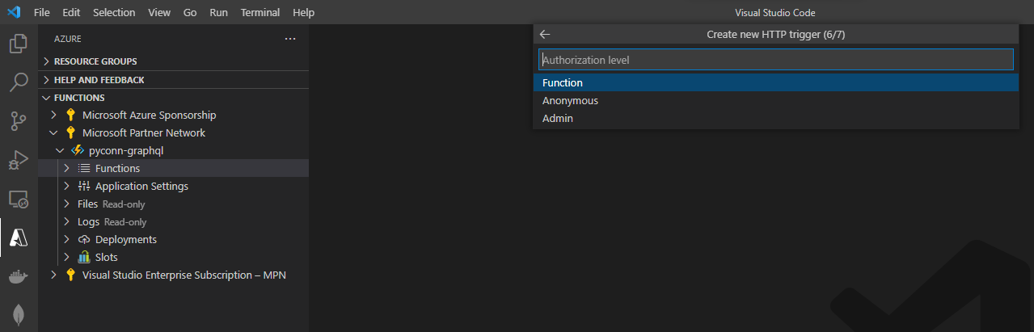
Azure Functions
Creating Azure Functions

Slide 28
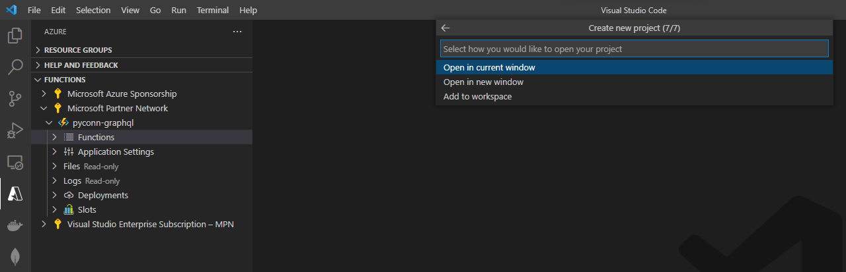
Azure Functions
Creating Azure Functions

Slide 29
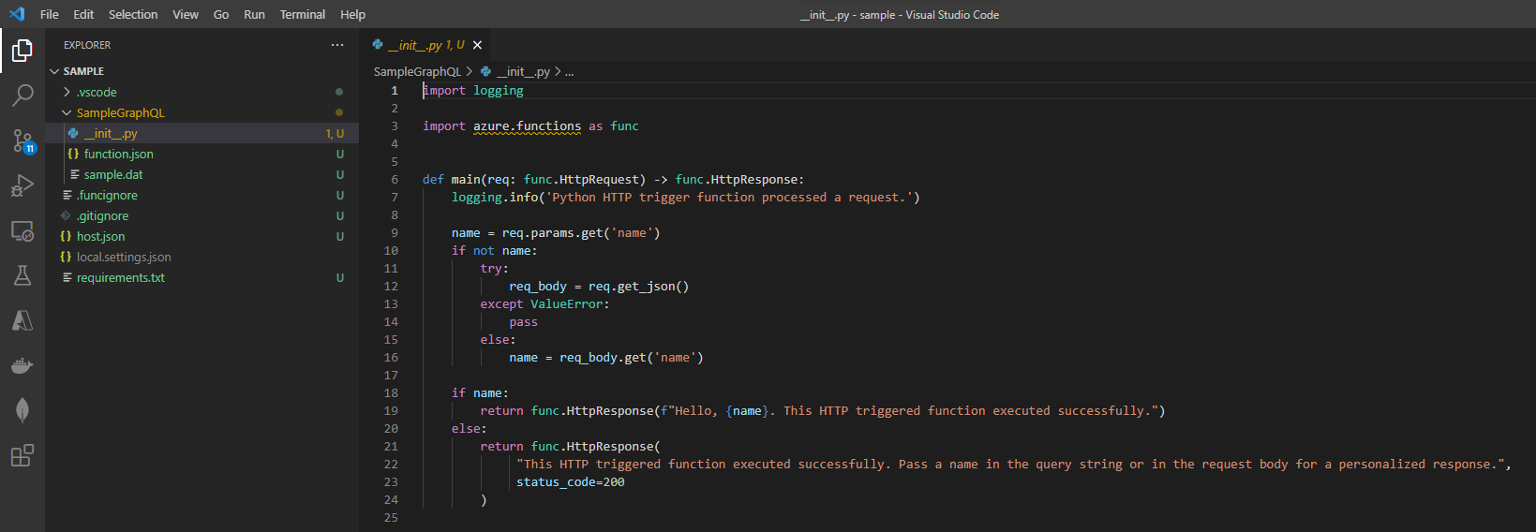
Azure Functions
Creating Azure Functions

Slide 30
Azure Functions
Project structure
SAMPLE: root directory
- requirements.txt : List of packages used on project to be installed when we deploy Azure Functions
- test.http : REST Client notebook to test our GraphQL
- SampleGraphQL : Package root also acted as our package name
- __init__.py : Init file for the project
- controllers
- graphql.py : Controller for GraphQL
- models
- memo.py : Model for database (using CosmosDB)

Slide 31
Azure Functions
requirements.txt
# DO NOT include azure-functions-worker in this file
# The Python Worker is managed by Azure Functions platform
# Manually managing azure-functions-worker may cause unexpected issues
azure-functions
azure-cosmos
graphene>=2.0

Slide 32
Azure Functions
__init__.py
import logging
import azure.functions as func
from SampleGraphQL.controllers.graphql import GraphQL
def main(req: func.HttpRequest) -> func.HttpResponse:
logging.info('Python HTTP trigger function processed a request.')
query = req.params.get('query')
if not query:
try:
req_body = req.get_json()
logging.info(req_body)
except ValueError as e:
logging.exception(e)
else:
query = req_body.get('query')
try:
results = GraphQL().query(query)
except Exception as e:
logging.exception(e)
return func.HttpResponse(
"Internal Server Error", status_code=500
)
if results:
return func.HttpResponse(f"{results}")
else:
return func.HttpResponse(
"Please pass a name on the query string or in the request body",
status_code=400
)

Slide 33
Azure Functions
memo.py
import logging
import os
from azure.cosmos import CosmosClient, PartitionKey, exceptions
from azure.cosmos.container import ContainerProxy
from azure.cosmos.database import DatabaseProxy
class DatabaseConnection():
def __init__(self):
# Initialize Cosmos Client
self.client = CosmosClient(os.environ["ACCOUNT_URI"], credential=os.environ["ACCOUNT_KEY"])
self.container_id = os.environ["CONTAINER"]
self.database_id = os.environ["DATABASE"]
# Create database
def init_database(self, database_id=os.environ["DATABASE"]) -> DatabaseProxy:
try:
self.database_id = database_id
return self.client.create_database_if_not_exists(database_id)
except Exception as e:
raise e
# Create a container
def init_container(self, database_id=os.environ["DATABASE"], container_id=os.environ["CONTAINER"]) -> ContainerProxy:
try:
db_client = self.init_database(database_id)
self.container_id = container_id
return db_client.create_container_if_not_exists(id=container_id, partition_key=PartitionKey(path='/topic'))
except Exception as e:
raise e
# Upsert item to the container
def upsert_item(self, item):
try:
container = self.init_container()
return container.upsert_item(item)
except exceptions.CosmosResourceNotFoundError as e:
logging.exception(f'A collection with id "{self.container_id}" does not exist')
raise e
except Exception as e:
raise e

Slide 34
Azure Functions
memo.py
# Delete item to the container
def delete_item(self, item):
query = f'SELECT * FROM c WHERE c.id = "{item["id"]}"'
try:
result = []
container = self.init_container()
for item in container.query_items(query=query, enable_cross_partition_query=True):
container.delete_item(item, partition_key=item["topic"])
result.append(item)
return result
except exceptions.CosmosResourceNotFoundError as e:
logging.exception(f'A collection with id "{self.container_id}" does not exist')
raise e
except Exception as e:
raise e
# Read item from container
def read_item(self, item):
query = f'SELECT * FROM c WHERE c.id = "{item["id"]}"'
print('query:', query)
try:
container = self.init_container()
result = list(container.query_items(query=query, enable_cross_partition_query=True, max_item_count=10))
print(result)
return result
except exceptions.CosmosResourceNotFoundError as e:
logging.exception(f'A collection with id "{self.container_id}" does not exist')
raise e
except Exception as e:
raise e

Slide 35
Azure Functions
memo.py
# Read all items from container
def read_items(self):
try:
container = self.init_container()
return list(container.read_all_items(enable_cross_partition_query=True, max_item_count=10))
except exceptions.CosmosResourceNotFoundError as e:
logging.exception(f'A collection with id "{self.container_id}" does not exist')
raise e
except Exception as e:
raise e

Slide 36
Azure Functions
graphql.py
import json
import graphene
import uuid
from datetime import datetime, timezone
from graphene.types.scalars import String
from SampleGraphQL.models.memo import DatabaseConnection
# Type DBItem
class Memo(graphene.ObjectType):
id = graphene.String(required=True)
topic = graphene.String()
message = graphene.String()
tags = graphene.List(String)
ts = graphene.Int()
datetime = graphene.types.datetime.DateTime()
def resolve_datetime(self, info):
return datetime.fromtimestamp(self._ts)
# Type Query
class Query(graphene.ObjectType):
hello = graphene.String(argument=graphene.String(default_value="world."))
memo = graphene.Field(Memo, id=graphene.String())
memos = graphene.List(Memo)
def resolve_hello(self, info, argument):
return f'Hello {argument}'
def resolve_memo(self, info, id):
args = {'id': id}
results = DatabaseConnection().read_item(args)
if len(results) > 0:
item = Memo.__new__(Memo)
item.__dict__.update(results[0])
return item
else:
return {}
def resolve_memos(self, info):
results = []
for item in DatabaseConnection().read_items():
i = Memo.__new__(Memo)
i.__dict__.update(item)
results.append(i)
return results

Slide 37
Azure Functions
graphql.py
# input MemoInput
class MemoInput(graphene.InputObjectType):
id = graphene.String(required=True)
topic = graphene.String()
message = graphene.String()
tags = graphene.List(String)
# Create item
class CreateItem(graphene.Mutation):
class Arguments:
item = MemoInput(required=True)
Output = Memo
def mutate(self, info, item):
results = DatabaseConnection().upsert_item(item)
i = Memo.__new__(Memo)
i.__dict__.update(results)
return i
# Delete item
class DeleteItem(graphene.Mutation):
class Arguments:
item = MemoInput(required=True)
Output = Memo
def mutate(self, info, item):
results = DatabaseConnection().delete_item(item)
if len(results) > 0:
i = Memo.__new__(Memo)
i.__dict__.update(results[0])
return i
return None
# Upsert item
class UpsertItem(graphene.Mutation):
class Arguments:
item = MemoInput(required=True)
Output = Memo
def mutate(self, info, item):
results = DatabaseConnection().upsert_item(item)
i = Memo.__new__(Memo)
i.__dict__.update(results)
return i

Slide 38
Azure Functions
graphql.py
# Random item
class RandomItem(graphene.Mutation):
Output = Memo
def mutate(self, info):
item = {
'id': str(uuid.uuid4()).replace('-', ''),
'topic': 'Auto Generated',
'message': 'Sample message',
'tags': ['sample', 'auto message']
}
results = DatabaseConnection().upsert_item(item)
i = Memo.__new__(Memo)
i.__dict__.update(results)
return i
# type Mutation
class Mutation(graphene.ObjectType):
create = CreateItem.Field()
delete = DeleteItem.Field()
upsert = UpsertItem.Field()
random = RandomItem.Field()
sample = graphene.String()
def resolve_sample(self, info):
item = {
'id': str(uuid.uuid4()).replace('-', ''),
'topic': 'Auto Generated',
'message': 'Sample message',
'tags': ['sample', 'auto message']
}
results = DatabaseConnection().upsert_item(item)
i = Memo.__new__(Memo)
i.__dict__.update(results)
return i

Slide 39
Azure Functions
graphql.py
class GraphQL:
def __init__(self):
self.schema = graphene.Schema(
query=Query,
mutation=Mutation
)
def query(self, query):
results = self.schema.execute(query)
return json.dumps(results.data)
def queryWithContext(self, query, context):
results = self.schema.execute(query, context=context)
return results

Slide 40
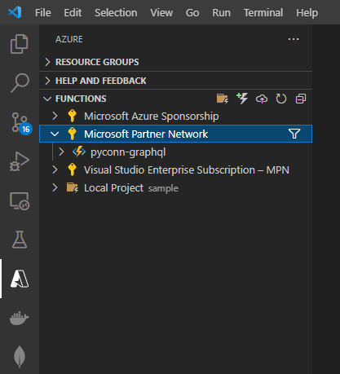
Azure Functions
Deploy function

Slide 41
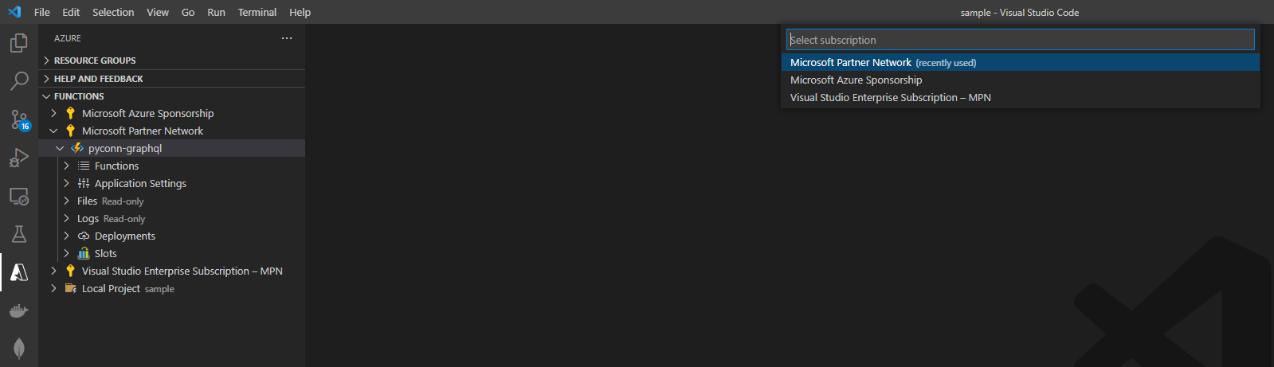
Azure Functions
Deploy function

Slide 42
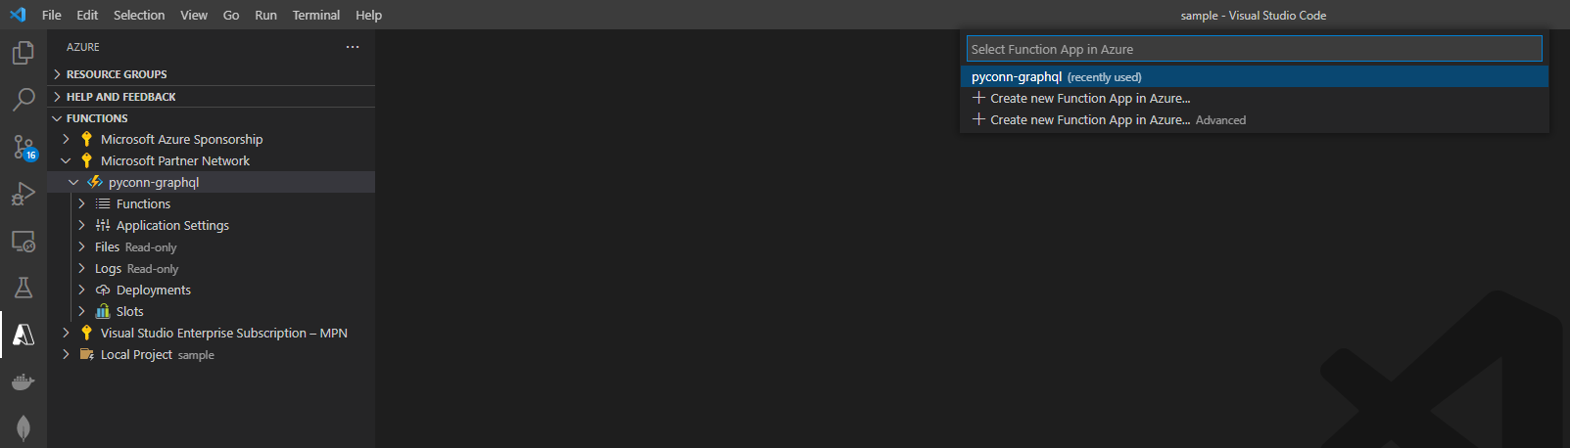
Azure Functions
Deploy function

Slide 43
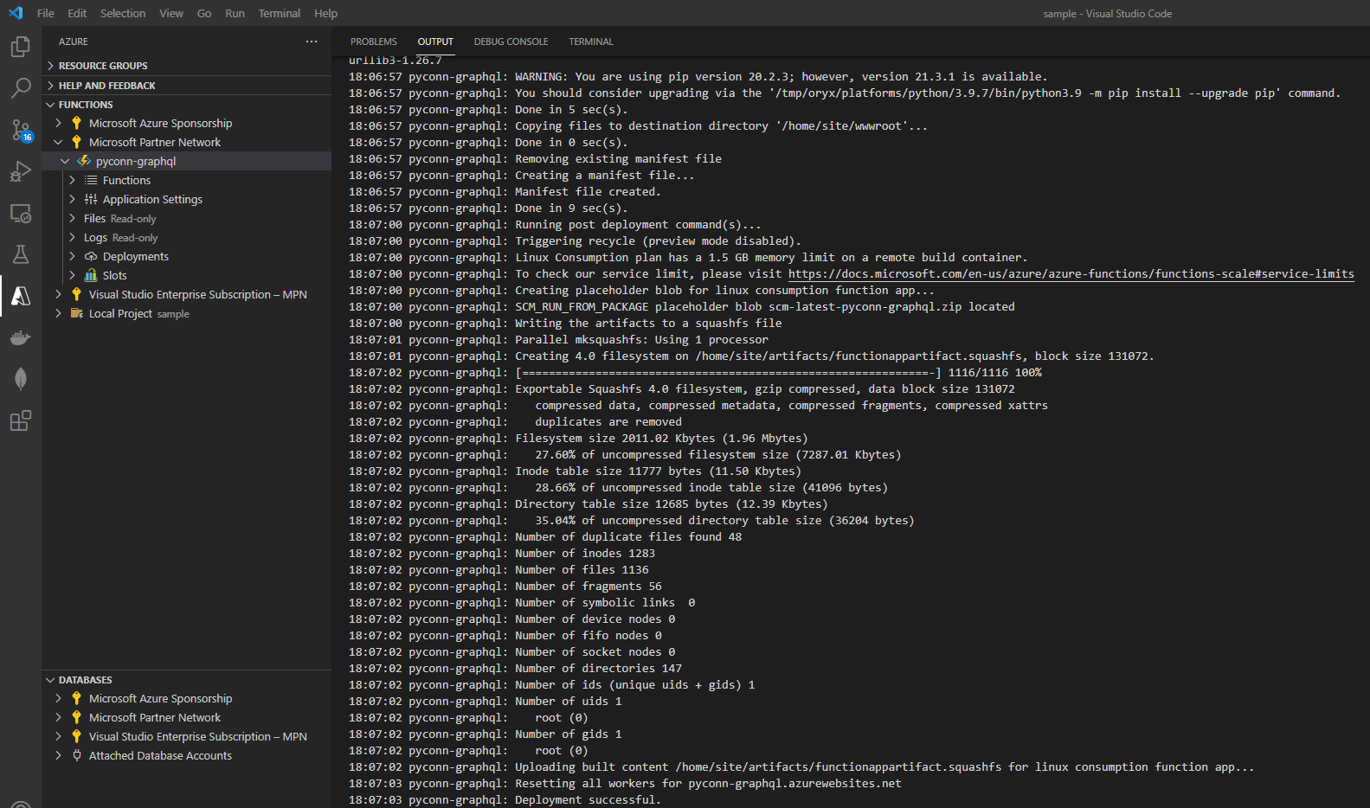
Azure Functions
Deploy function

Slide 44
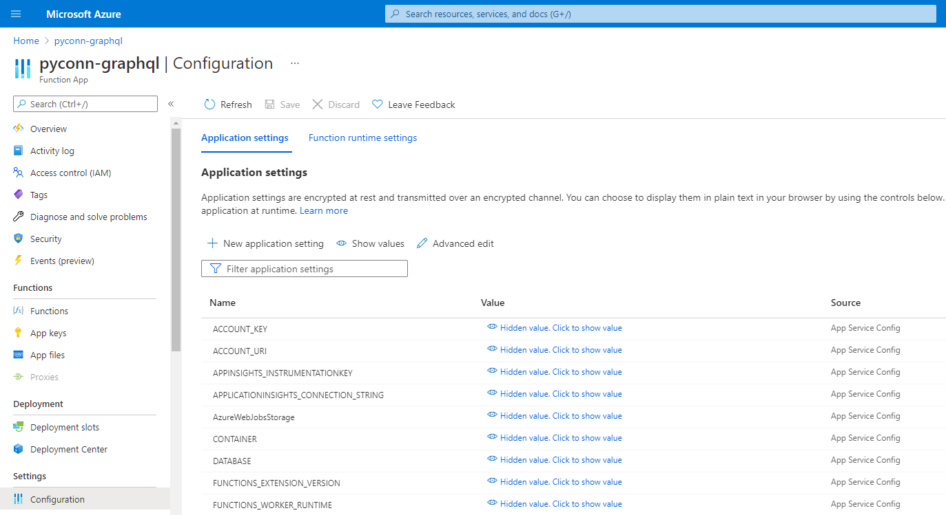
Azure Functions
Add application settings

Slide 45
Azure Functions
Test GraphQL on AzureQL
### JSON (RESTAPI?) Style
POST https://pyconn-graphql.azurewebsites.net/api/SampleGraphQL?code=N4gDSYqmm0qMVAeelWaAY51tJAbTXo/BJH5ABnwf6fRmE5xWZXZzZw==
Content-Type: application/json
{
"query": "query list { memos { id topic message tags datetime } }"
}
HTTP/1.1 200 OK
Transfer-Encoding: chunked
Content-Type: text/plain; charset=utf-8
Server: Kestrel
Request-Context: appId=cid-v1:3e55a6a4-fc5c-4b0e-8d14-d90f743828f5
Date: Sat, 04 Dec 2021 11:42:06 GMT
Connection: close
{ "memos": [ { "id": "1936e085d7fa432785a06bc73e52194b", "topic": "Auto Generated", "message": "Sample message", "tags": [ "sample", "auto message" ], "datetime": "2021-12-03T11:19:55" }, { "id": "fdd372387f56483ab52e51ec4bea102e", "topic": "Auto Generated", "message": "Sample message", "tags": [ "sample", "auto message" ], "datetime": "2021-12-03T11:46:01" } ] }

Slide 46
Azure Functions
Test GraphQL on AzureQL
### GraphQL style
POST https://pyconn-graphql.azurewebsites.net/api/SampleGraphQL?code=N4gDSYqmm0qMVAeelWaAY51tJAbTXo/BJH5ABnwf6fRmE5xWZXZzZw==
Content-Type: application/json
X-REQUEST-TYPE: GraphQL
query list {
memos {
id
topic
message
tags
datetime
}
}
HTTP/1.1 200 OK
Transfer-Encoding: chunked
Content-Type: text/plain; charset=utf-8
Server: Kestrel
Request-Context: appId=cid-v1:3e55a6a4-fc5c-4b0e-8d14-d90f743828f5
Date: Sat, 04 Dec 2021 11:43:10 GMT
Connection: close
{ "memos": [ { "id": "1936e085d7fa432785a06bc73e52194b", "topic": "Auto Generated", "message": "Sample message", "tags": [ "sample", "auto message" ], "datetime": "2021-12-03T11:19:55" }, { "id": "fdd372387f56483ab52e51ec4bea102e", "topic": "Auto Generated", "message": "Sample message", "tags": [ "sample", "auto message" ], "datetime": "2021-12-03T11:46:01" } ] }

Slide 47
Azure Functions
Test GraphQL on AzureQL
POST https://pyconn-graphql.azurewebsites.net/api/SampleGraphQL?code=N4gDSYqmm0qMVAeelWaAY51tJAbTXo/BJH5ABnwf6fRmE5xWZXZzZw==
Content-Type: application/json
X-REQUEST-TYPE: GraphQL
mutation mutate_memo {
create(item: {id: "memotest123", topic: "Mutation", message: "Insert into document memo", tags: ["manual", "mutation", "test"]}) {
id
topic
message
tags
datetime
}
}
HTTP/1.1 200 OK
Transfer-Encoding: chunked
Content-Type: text/plain; charset=utf-8
Server: Kestrel
Request-Context: appId=cid-v1:3e55a6a4-fc5c-4b0e-8d14-d90f743828f5
Date: Sat, 04 Dec 2021 11:44:08 GMT
Connection: close
{ "create": { "id": "memotest123", "topic": "Mutation", "message": "Insert into document memo", "tags": [ "manual", "mutation", "test" ], "datetime": "2021-12-04T11:44:09" } }

Slide 48
Azure Functions
Test GraphQL on AzureQL
POST https://pyconn-graphql.azurewebsites.net/api/SampleGraphQL?code=N4gDSYqmm0qMVAeelWaAY51tJAbTXo/BJH5ABnwf6fRmE5xWZXZzZw==
Content-Type: application/json
X-REQUEST-TYPE: GraphQL
query list {
memo(id: "memotest123") {
id
topic
message
tags
datetime
}
}
HTTP/1.1 200 OK
Transfer-Encoding: chunked
Content-Type: text/plain; charset=utf-8
Server: Kestrel
Request-Context: appId=cid-v1:3e55a6a4-fc5c-4b0e-8d14-d90f743828f5
Date: Sat, 04 Dec 2021 11:45:01 GMT
Connection: close
{ "memo": { "id": "memotest123", "topic": "Mutation", "message": "Insert into document memo", "tags": [ "manual", "mutation", "test" ], "datetime": "2021-12-04T11:44:09" } }

Slide 49
Azure Functions
Test GraphQL on AzureQL
POST https://pyconn-graphql.azurewebsites.net/api/SampleGraphQL?code=N4gDSYqmm0qMVAeelWaAY51tJAbTXo/BJH5ABnwf6fRmE5xWZXZzZw==
Content-Type: application/json
X-REQUEST-TYPE: GraphQL
mutation delete_memo {
delete(item: {id: "memotest123"}) {
id
topic
message
tags
datetime
}
}
HTTP/1.1 200 OK
Transfer-Encoding: chunked
Content-Type: text/plain; charset=utf-8
Server: Kestrel
Request-Context: appId=cid-v1:3e55a6a4-fc5c-4b0e-8d14-d90f743828f5
Date: Sat, 04 Dec 2021 11:45:49 GMT
Connection: close
{ "delete": { "id": "memotest123", "topic": "Mutation", "message": "Insert into document memo", "tags": [ "manual", "mutation", "test" ], "datetime": "2021-12-04T11:44:09" } }

Slide 50
Azure Functions
Test GraphQL on AzureQL
POST https://pyconn-graphql.azurewebsites.net/api/SampleGraphQL?code=N4gDSYqmm0qMVAeelWaAY51tJAbTXo/BJH5ABnwf6fRmE5xWZXZzZw==
Content-Type: application/json
X-REQUEST-TYPE: GraphQL
query list {
memo(id: "memotest123") {
id
topic
message
tags
datetime
}
}
HTTP/1.1 200 OK
Transfer-Encoding: chunked
Content-Type: text/plain; charset=utf-8
Server: Kestrel
Request-Context: appId=cid-v1:3e55a6a4-fc5c-4b0e-8d14-d90f743828f5
Date: Sat, 04 Dec 2021 11:47:17 GMT
Connection: close
{ "memo": null }

Slide 51
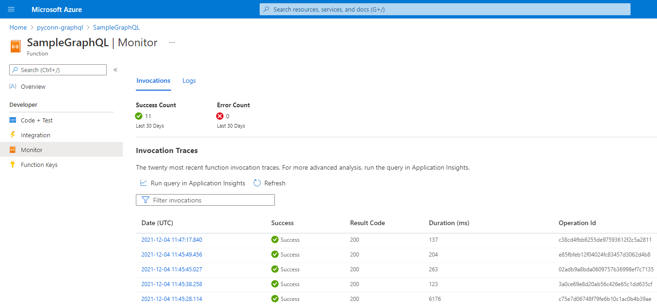
Azure Functions
Monitoring API

Slide 52

take you closer to AI
Contact us
© 2021 XQUISITE AI. All rights reserved.
The information herein is for informational purposes only and represents the current view of XQUISITE AI as of the date of this submission. XQUISITE AI retain the rights to alter the information in this document without prior notice.

